Slide 1
21CSS201T COMPUTER ORGANIZATION AND ARCHITECTURE UNIT-1

Slide 2
Computer Architecture Objectives
Know the difference between computer organization and computer architecture.
Understand units of measure common to computer systems
Appreciate the evolution of computers.
Understand the computer as a layered system.
Be able to explain the von Neumann architecture and the function of basic computer components.

Slide 3
Overview
A modern computer is an electronic, digital, general purpose computing machine that automatically follows a step-by-step list of instructions to solve a problem. This step-by step list of instructions that a computer follows is also called an algorithm or a computer program.
Why study computer organization and architecture?
Design better programs, including system software such as compilers, operating systems, and device drivers.
Optimize program behavior.
Evaluate (benchmark) computer system performance.
Understand time, space, and price tradeoffs.
Computer organization
Encompasses all physical aspects of computer systems.
E.g., circuit design, control signals, memory types.
How does a computer work?

Slide 4
Computer architecture
Focuses on the structure(the way in which the components are interrelated) and behavior of the computer system and refers to the logical aspects of system implementation as seen by the programmer
Computer architecture includes many elements such as
instruction sets and formats, operation codes, data types, the number and types of registers, addressing modes, main memory access methods, and various I/O mechanisms.
The architecture of a system directly affects the logical execution of programs.
The computer architecture for a given machine is the combination of its hardware components plus its instruction set architecture (ISA).
The ISA is the interface between all the software that runs on the machine and the hard
Studying computer architecture helps us to answer the question: How do I design a computer?

Slide 5
Overview
In the case of the IBM, SUN and Intel ISAs, it is possible to purchase processors which execute the same instructions from more than one manufacturer
All these processors may have quite different internal organizations but they all appear identical to a programmer, because their instruction sets are the same
Organization & Architecture enables a family of computer models
Same Architecture, but with differences in Organization
Different price and performance characteristics
When technology changes, only organization changes
This gives code compatibility (backwards)

Slide 6
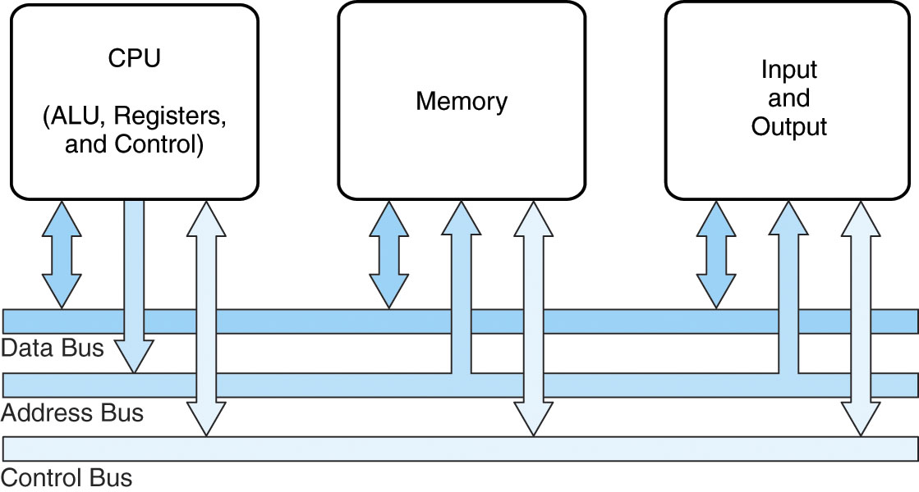
Computer Components
At the most basic level, a computer is a device consisting of 3 pieces
A processor to interpret and execute programs
A memory ( Includes Cache, RAM, ROM) to store both data and program instructions
A mechanism for transferring data to and from the outside world.
I/O to communicate between computer and the world
Bus to move info from one computer component to another

Slide 7
Contd..
Computers with large main memory capacity can run larger programs with greater speed than computers having small memories.
RAM is an acronym for random access memory. Random access means that memory contents can be accessed directly if you know its location.
Cache is a type of temporary memory that can be accessed faster than RAM.

Slide 8
Measures of capacity and speed
Kilo- (K) = 1 thousand = 10³ and 2¹⁰
Mega- (M) = 1 million = 10⁶ and 2²⁰
Giga- (G) = 1 billion = 10⁹ and 2³⁰
Tera- (T) = 1 trillion = 10¹² and 2⁴⁰
Peta- (P) = 1 quadrillion = 10¹⁵ and 2⁵⁰
Exa- (E) = 1 quintillion = 10¹⁸ and 2⁶⁰
Zetta-(Z) = 1 sextillion = 10²¹ and 2⁷⁰
Yotta-(Y) = 1 septillion = 10²⁴ and 2⁸⁰
Whether a metric refers to a power of 10 or a power of 2 typically depends upon what is being measured.
Hertz = clock cycles per second (frequency)
1MHz = 1,000,000Hz
Processor speeds are measured in MHz or GHz.
Byte = a unit of storage
1KB = 2¹⁰ = 1024 Bytes
1MB = 2²⁰ = 1,048,576 Bytes
Main memory (RAM) is measured in MB
Disk storage is measured in GB for small systems, TB for large systems.

Slide 9
Contd..
Measures of time and space:
Milli- (m) = 1 thousandth = 10 ⁻³
Micro- (μ) = 1 millionth = 10 ⁻⁶
Nano- (n) = 1 billionth = 10 ⁻⁹
Pico- (p) = 1 trillionth = 10 ⁻¹²
Femto- (f) = 1 quadrillionth = 10 ⁻¹⁵
Atto- (a) = 1 quintillionth = 10 ⁻¹⁸
Zepto- (z) = 1 sextillionth = 10 ⁻²¹
Yocto- (y) = 1 septillionth = 10 ⁻²⁴
We note that cycle time is the reciprocal of clock frequency.
A bus operating at 133MHz has a cycle time of 7.52 nanoseconds
Millisecond = 1 thousandth of a second
Hard disk drive access times are often 10 to 20 milliseconds.
Nanosecond = 1 billionth of a second
Main memory access times are often 50 to 70 nanoseconds.
Micron (micrometer) = 1 millionth of a meter
Circuits on computer chips are measured in microns.

Slide 10
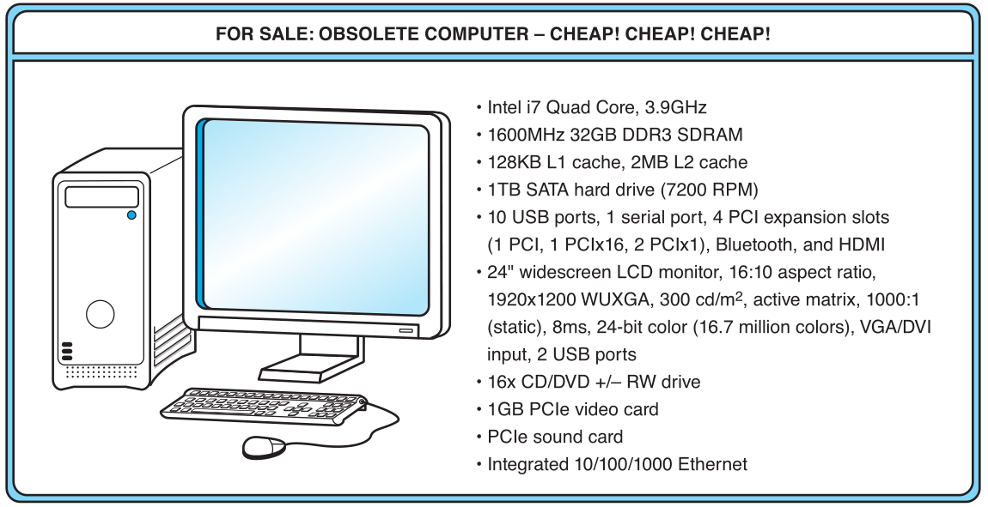
An Example System
What does it all mean??

Slide 11
The microprocessor is the “brain” of the system. It executes program instructions. This one is an Intel i7 running at 3.9GHz.

Slide 12
An Example System
This system has 32GB of (fast) synchronous dynamic RAM (SDRAM)
2 levels of cache memory
the level 1 (L1) cache is smaller and faster than the L2 cache. Note that these cache sizes are measured in KB and MB.

Slide 13
An Example System
Hard disk capacity determines the amount of data and size of programs you can store.
This one can store 1TB. 7200 RPM is the rotational speed of the disk. Generally, the faster a disk rotates, the faster it can deliver data to RAM. (There are many other factors involved.)

Slide 14
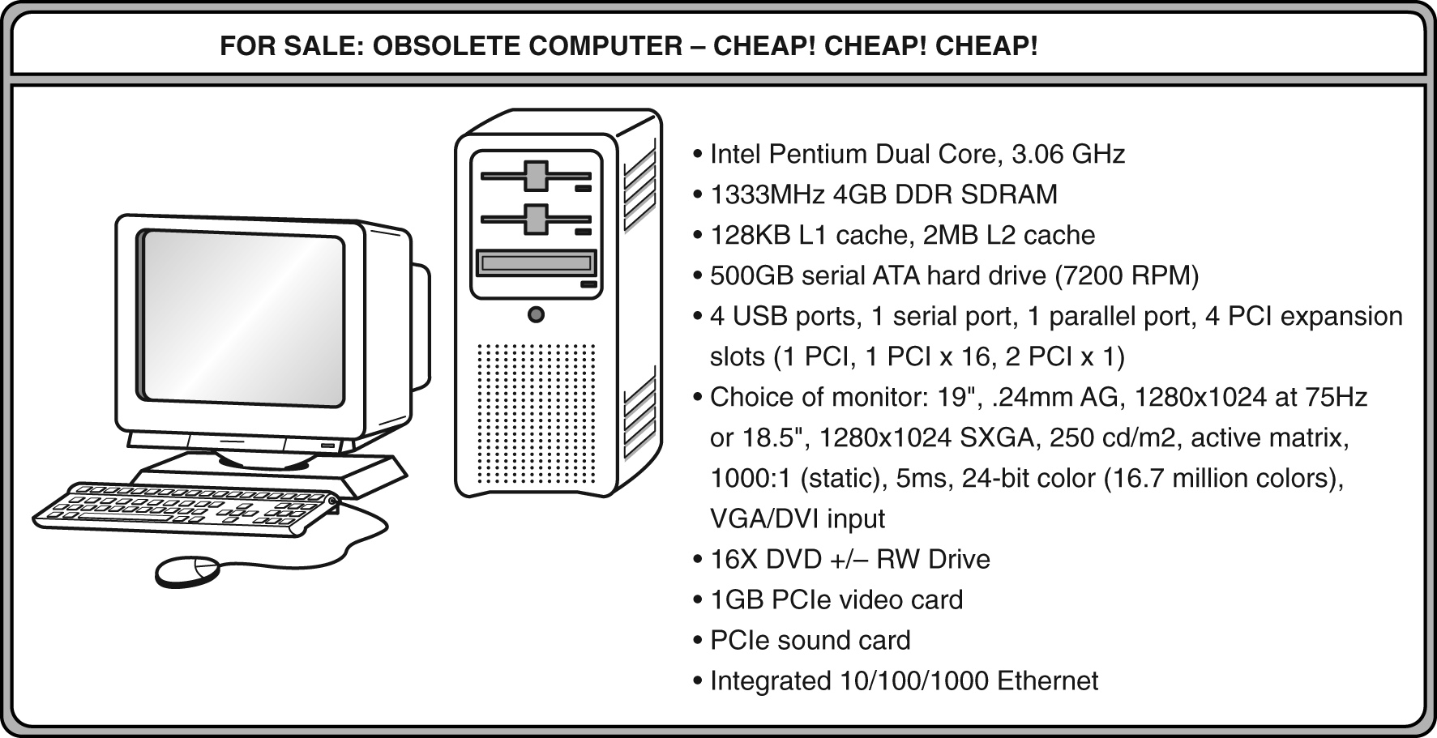
1.3 An Example System
ATA advanced technology attachment, which describes how the hard disk interfaces with (or connects to) other system components
DVD can store about 4.7GB of data. This drive supports rewritable DVDs, +/-RW, that can be written to many times.. 16x describes its speed.

Slide 15
An Example System
Ports allow movement of data between a system and its external devices.
This system has ten ports.

Slide 16
An Example System
System buses can be augmented by dedicated I/O buses. PCI, peripheral component interface, is one such bus.
This system has two PCIe (PCI express) devices: a video card and a sound card.

Slide 17
An Example System
Active matrix technology uses one transistor per picture element (pixel). The resolution of a monitor determines the amount of text and graphics that the monitor can display.
Super VGA (SVGA) tells us this monitor has a resolution of 1280 × 1024 pixels.
The video card contains memory and programs that support the monitor.

Slide 18
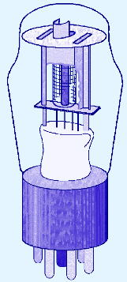
1st Generation Computers
Used vacuum tubes for logic and storage (very little storage available)
A vacuum-tube circuit storing 1 byte
Programmed in machine language
Often programmed by physical connection (hardwiring)
Slow, unreliable, expensive
The ENIAC – often thought of as the first programmable electronic computer – 1946
17468 vacuum tubes, 1800 square feet, 30 tons

Slide 19
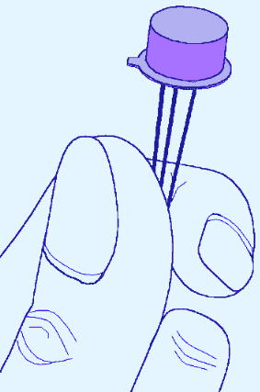
2nd Generation Computers
Transistors replaced vacuum tubes
Magnetic core memory introduced
Changes in technology brought about cheaper and more reliable computers (vacuum tubes were very unreliable)
Because these units were smaller, they were closer together providing a speedup over vacuum tubes
Various programming languages introduced (assembly, high-level)
Rudimentary OS developed
The first supercomputer was introduced, CDC 6600 ($10 million)

Slide 20
3rd Generation Computers Integrated circuit (IC)
The ability to place circuits onto silicon chips
Replaced both transistors and magnetic core memory
Result was easily mass-produced components reducing the cost of computer manufacturing significantly
Also increased speed and memory capacity
Computer families introduced
Minicomputers introduced
More sophisticated programming languages and OS developed
Popular computers included PDP-8, PDP-11, IBM 360 and Cray produced their first supercomputer, Cray-1
Silicon chips now contained both logic (CPU) and memory
Large-scale computer usage led to time-sharing OS

Slide 21
4th Generation Computers 1971-Present: Microprocessors
Miniaturization took over
From SSI (10-100 components per chip) to
MSI (100-1000), LSI (1,000-10,000), VLSI (10,000+)
Thousands of ICs were built onto a single silicon chip(VLSI), which allowed Intel, in 1971, to
create the world’s first microprocessor, the 4004, which was a fully functional, 4-bit system that ran at 108KHz.
Intel also introduced the RAM chip, accommodating 4Kb of memory on a single chip. This allowed computers of the 4th generation to become smaller and faster than their solid-state predecessors
Computers also saw the development of GUIs, the mouse and handheld devices

Slide 22
Moore’s Law
How small can we make transistors?
How densely can we pack chips?
No one can say for sure
In 1965, Intel founder Gordon Moore stated,
“The density of transistors in an integrated circuit will
double every year.”
The current version of this prediction is usually conveyed as “the density of silicon chips doubles every 18 months”
Using current technology, Moore’s Law cannot hold forever
There are physical and financial limitations
At the current rate of miniaturization, it would take about 500 years to put the entire solar system on a chip
Cost may be the ultimate constraint

Slide 23
Rock’s Law
Arthur Rock, is a corollary to Moore’s law: “The cost of capital equipment to build semiconductor will double every four years”
Rock’s Law arises from the observations of a financier who has seen the price tag of new chip facilities escalate from about $12,000 in 1968 to $12 million in the late 1990s.
At this rate, by the year 2035, not only will the size of a memory element be smaller than an atom, but it would also require the entire wealth of the world to build a single chip!
So even if we continue to make chips smaller and faster, the ultimate question may be whether we can afford to build them

Slide 24
The Computer Level Hierarchy
Through the principle of abstraction, we can imagine the machine to be built from a hierarchy of levels, in which each level has a specific function and exists as a distinct hypothetical Machine
Abstraction is the ability to focus on important aspects of a situation at a higher level while ignoring the underlying complex details
We call the hypothetical computer at each level a virtual machine.
Each level’s virtual machine executes its own particular set of instructions, calling upon machines at lower levels to carry out the tasks when necessary

Slide 25
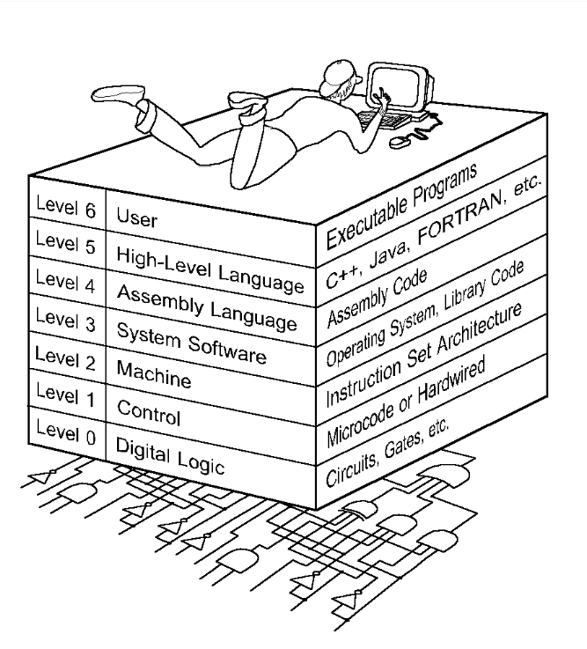
1.6 The Computer Level Hierarchy
Level 6: The User Level
Composed of applications and is the level with which everyone is most familiar.
At this level, we run programs such as word processors, graphics packages, or games. The lower levels are nearly invisible from the User Level.

Slide 26
Level 5: High-Level Language Level
The level with which we interact when we write programs in languages such as C, Pascal, Lisp, and Java
These languages must be translated to a language the machine can understand. (using compiler / interpreter)
Compiled languages are translated into assembly language and then assembled into machine code. (They are translated to the next lower level.)
The user at this level sees very little of the lower levels

Slide 27
Level 4: Assembly Language Level
Acts upon assembly language produced from Level 5, as well as instructions programmed directly at this level
As previously mentioned, compiled higher-level languages are first translated to assembly, which is then directly translated to machine language. This is a one-to-one translation, meaning that one assembly language instruction is translated to exactly one machine language instruction.
By having separate levels, we reduce the semantic gap between a high-level language and the actual machine language

Slide 28
Level 3: System Software Level
deals with operating system instructions.
This level is responsible for multiprogramming, protecting memory, synchronizing processes, and various other important functions.
Often, instructions translated from assembly language to machine language are passed through this level unmodified

Slide 29
Level 2: Machine Level
Consists of instructions (ISA)that are particular to the architecture of the machine
Programs written in machine language need no compilers, interpreters, or assemblers
Level 1: Control Level
A control unit decodes and executes instructions and moves data through the system.
Control units can be microprogrammed or hardwired
A microprogram is a program written in a low-level language that is implemented by the hardware.
Hardwired control units consist of hardware that directly executes machine instruction

Slide 30

Level 0: Digital Logic Level
This level is where we find digital circuits (the chips)
Digital circuits consist of gates and wires.
These components implement the mathematical logic of all other levels

Slide 31
The Von Neumann Architecture
Named after John von Neumann, Princeton, he designed a computer architecture whereby data and instructions would be retrieved from memory, operated on by an ALU, and moved back to memory (or I/O)
This architecture is the basis for most modern computers (only parallel processors and a few other unique architectures use a different model)

Slide 32
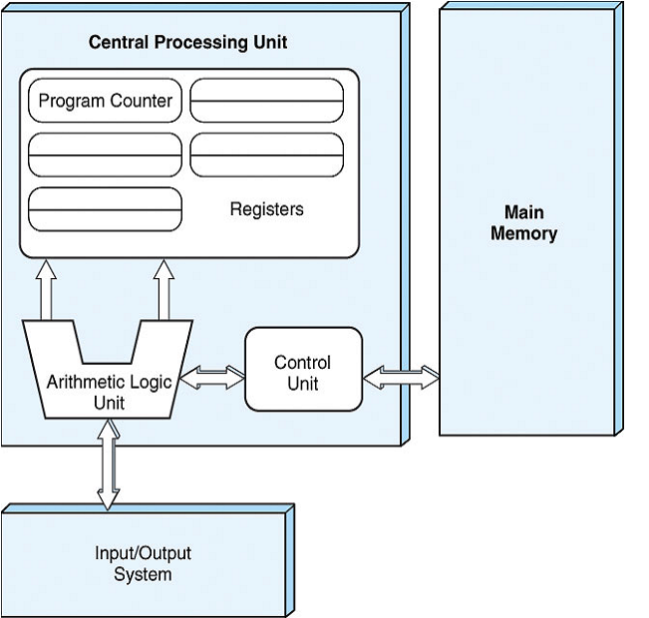
Hardware consists of 3 units
CPU (control unit, ALU, registers)
Memory (stores programs and data)
I/O System (including secondary storage)
Instructions in memory are executed sequentially unless a program instruction explicitly changes the order

Slide 33
Von Neumann Architectures
There is a single pathway used to move both data and instructions between memory, I/O and CPU
the pathway is implemented as a bus
the single pathway creates a bottleneck
known as the von Neumann bottleneck
A variation of this architecture is the Harvard architecture which separates data and instructions into two pathways
Another variation, used in most computers, is the system bus version in which there are different buses between CPU and memory and memory and I/O

Slide 34
Fetch-execute cycle
The von Neumann architecture operates on the fetch-execute cycle
Fetch an instruction from memory as indicated by the Program Counter register
Decode the instruction in the control unit
Data operands needed for the instruction are fetched from memory
Execute the instruction in the ALU storing the result in a register
Move the result back to memory if needed

Slide 35
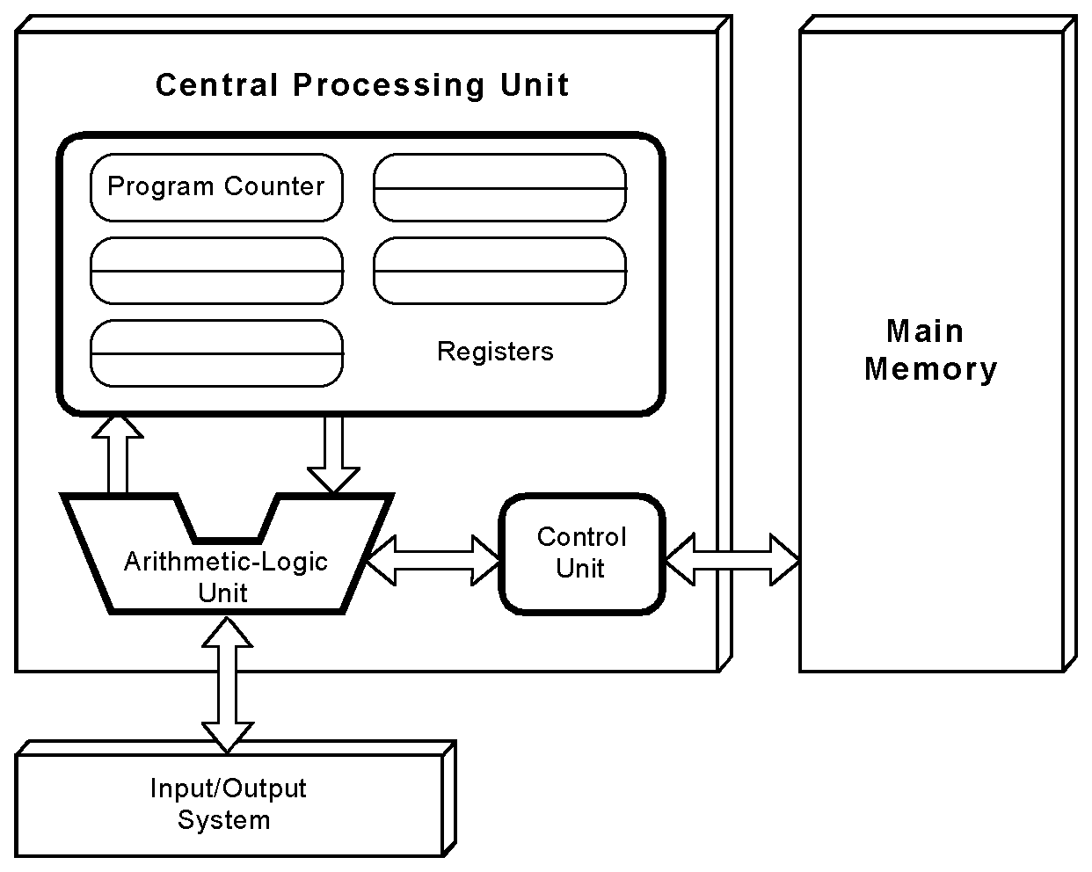
The von Neumann Model
This is a general depiction of a von Neumann system:
These computers employ a fetch-decode-execute cycle to run programs as follows . . .

Slide 36
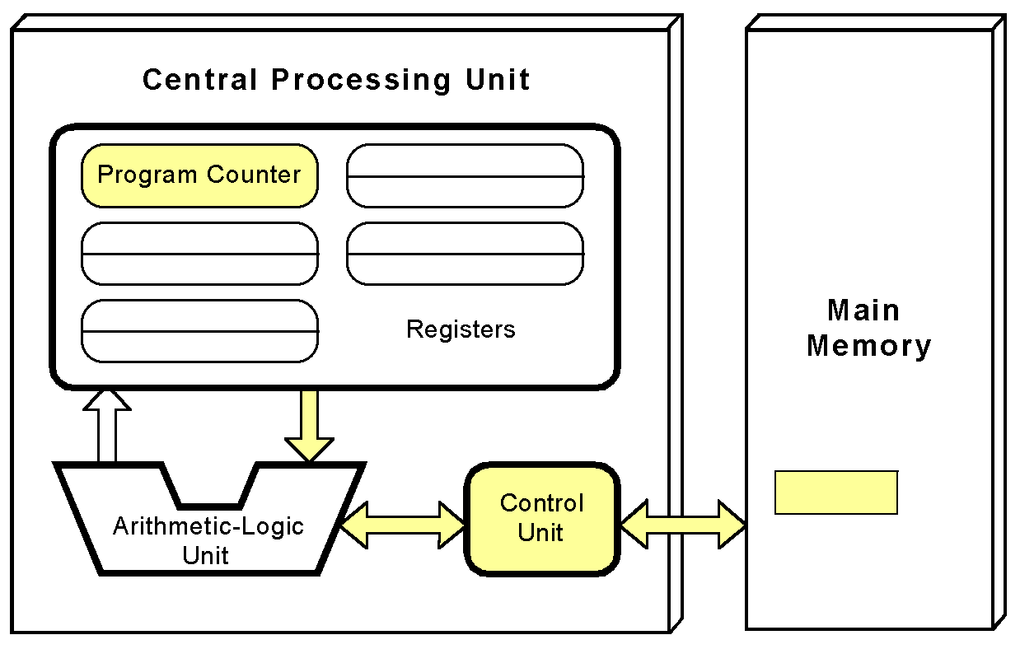
The von Neumann Model
The control unit fetches the next instruction from memory using the program counter to determine where the instruction is located

Slide 37
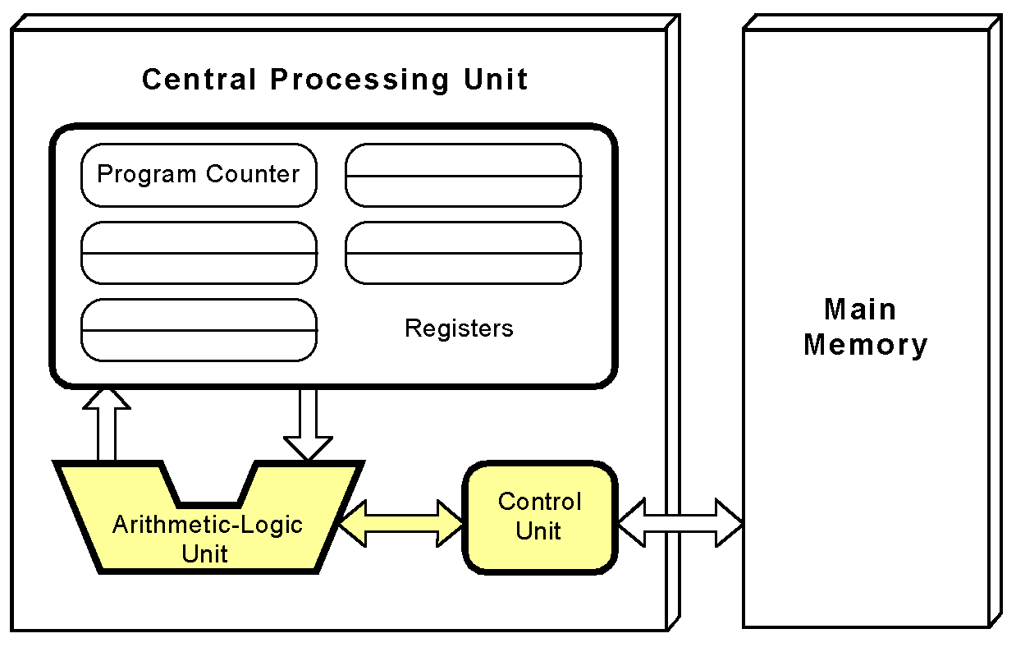
The von Neumann Model
The instruction is decoded into a language that the ALU can understand.

Slide 38
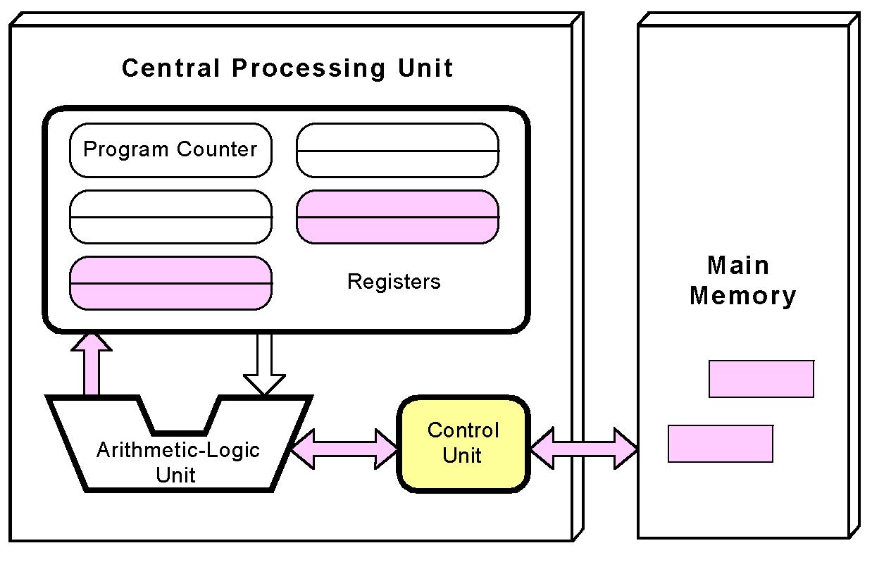
The von Neumann Model
Any data operands required to execute the instruction are fetched from memory and placed into registers within the CPU.

Slide 39
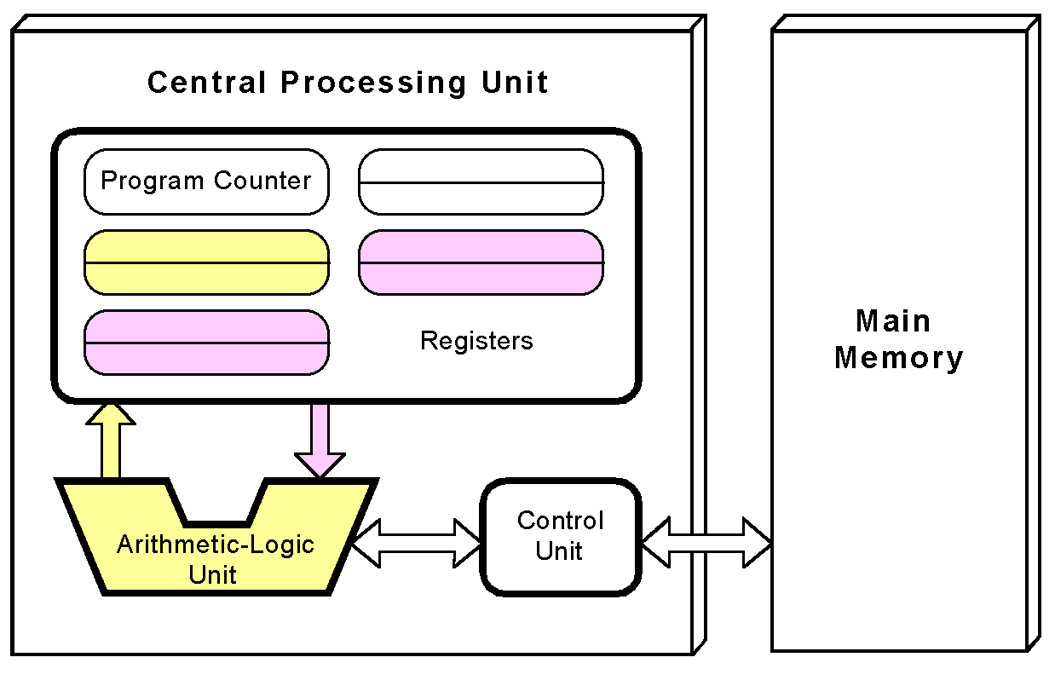
The von Neumann Model
The ALU executes the instruction and places results in registers or memory.

Slide 40
Non-von Neumann Models
Conventional stored-program computers have undergone many incremental improvements over the years
specialized buses
floating-point units
cache memories
But enormous improvements in computational power require departure from the classic von Neumann architecture
Adding processors is one approach

Slide 41
Non-von Neumann Models
In the late 1960s, high-performance computer systems were equipped with dual processors to increase computational throughput.
In the 1970s supercomputer systems were introduced with 32 processors.
Supercomputers with 1,000 processors were built in the 1980s.
In 1999, IBM announced its Blue Gene system containing over 1 million processors.

Slide 42
Parallel Computing
Parallel processing allows a computer to simultaneously work on subparts of a problem.
Multicore processors have 2 or more processor cores sharing a single die.
Each core has its own ALU and set of registers, but all processors share memory and other resources.
“Dual core” differs from “dual processor.”
Dual-processor machines, have two processors, but each processor plugs into the motherboard separately.
Multi-core systems provide the ability to multitask
E.g., browse the Web while burning a CD
Multithreaded applications spread mini-processes, threads, across one or more processors for increased throughput.

Slide 43
Computing as a Service Cloud Computing
The ultimate aim of every computer system is to deliver functionality to its users.
Computer users typically do not care about terabytes of storage and gigahertz of processor speed.
Many companies outsource their data centers to 3rd-party specialists, who agree to provide computing services for a fee.
These arrangements are managed through service-level agreements (SLAs).
Rather than pay a third party to run a company-owned data center, another approach is to buy computing services from someone else’s data center and connect to it via the Internet.
This is the idea behind a collection of service models known as Cloud computing.

Slide 44
Cloud Computing
Enabling on-demand network access to a shared pool of configurable computing resources (e.g., networks, servers, applications, and services) that can be rapidly provisioned and released with minimal management effort or service provider interaction

Slide 45
Cloud Computing
Cloud computing models:
Software as a Service,
The consumer of this service buy application services
Platform as a Service,
Provides server hardware, operating systems, database services, security components, and backup and recovery services
Infrastructure as a Service
provides only server hardware, secure network access to the servers, and backup and recovery services. The customer is responsible for all system software including the operating system and databases

Slide 46
Grid computing
Combination of computer resources from multiple administrative domains to reach a common goal.
What distinguishes grid computing from conventional high performance computing systems s.a cluster computing is that grids tend to be more loosely coupled, heterogeneous, and geographically dispersed.
Although a grid can be dedicated to a specialized application, it is more common that a single grid will be used for a variety of different purposes

Slide 47
Cluster computing
A group of linked computers, working together closely thus in many respects forming a single computer. The components of a cluster are commonly, but not always, connected to each other through fast LANs
Clusters are usually deployed to improve performance and availability over that of a single computer, while typically being much more cost-effective than single computers of comparable speed or availability

Slide 48
Throughout the remainder of this book you will see how these components work and how they interact with software to make complete computer systems.
This statement raises two important questions
What assurance do we have that computer components will operate as we expect?
What assurance do we have that computer components will operate together?

Slide 49
Standards Organizations
There are many organizations that set computer hardware standards to include the interoperability of computer components
Institute of Electrical and Electronic Engineers (IEEE)
Establishes standards for computer components, data representation, among many other things
The International Telecommunications Union (ITU)
Concerns itself with the interoperability of telecommunications systems, including data communications and telephony
The American National Standards Institute (ANSI)
The British Standards Institution (BSI)
National groups establish standards within their respective countries
The International Organization for Standardization
Establishes worldwide standards for everything from screw threads to photographic film

Slide 50
Computer Performance Measures Program Execution Time
For a specific program compiled to run on a specific machine “A”, the following parameters are provided:
The total instruction count of the program.
The average number of cycles per instruction (average CPI).
Clock cycle of machine “A”
How can one measure the performance of this machine running this program?
The machine is said to be faster or has better performance running this program if the total execution time is shorter.
Thus the inverse of the total measured program execution time is a possible performance measure or metric:
Performance_{A} = 1 / Execution Time_{A}
How to compare performance of different machines?
What factors affect performance? How to improve performance?

Slide 51
Comparing Computer Performance Using Execution Time
To compare the performance of two machines “A”, “B” running a given specific program
Performance_{A} = 1 / Execution Time_{A}
Performance_{B} = 1 / Execution Time_{B}
Machine A is n times faster than machine B means:
Example:
For a given program:
Execution time on machine A: Execution_{A} = 1 second
Execution time on machine B: Execution_{B} = 10 seconds
Performance_{A} / Performance_{B} = Execution Time_{B} / Execution Time_{A}
= 10 / 1 = 10
The performance of machine A is 10 times the performance of machine B when
running this program, or: Machine A is said to be 10 times faster than machine B
when running this program.
Performance_{A}
Execution Time_{B}
Speedup = n = =
Performance_{B}
Execution Time_{A}

Slide 52
CPU Execution Time The CPU Equation
A program is comprised of a number of instructions executed ,
Measured in: instructions/program
The average instruction takes a number of cycles per instruction (CPI) to be completed.
Measured in: cycles/instruction, CPI
CPU has a fixed clock cycle time C = 1/clock rate
Measured in: seconds/cycle
CPU execution time is the product of the above three parameters as follows:
CPU time = Seconds = Instructions x Cycles x Seconds
Program Program Instruction Cycle
T = I x CPI x C

Slide 53
Example
A Program is running on a specific machine with the following parameters:
Total executed instruction count: 10,000,000 instructions
Average CPI for the program: 2.5 cycles/instruction.
CPU clock rate: 200 MHz.
What is the execution time for this program?
CPU time = Instruction count x CPI x Clock cycle
= 10,000,000 x 2.5 x 1 / clock rate
= 10,000,000 x 2.5 x 5x10⁻⁹
= .125 seconds

Slide 54
Example
From the previous example: A Program is running on a specific machine with the following parameters:
Total executed instruction count, I: 10,000,000 instructions
Average CPI for the program: 2.5 cycles/instruction.
CPU clock rate: 200 MHz.
Using the same program with these changes:
A new compiler used: New instruction count 9,500,000
New CPI: 3.0
Faster CPU implementation: New clock rate = 300 MHZ
What is the speedup with the changes?
Speedup = (10,000,000 x 2.5 x 5x10⁻⁹) / (9,500,000 x 3 x 3.33x10⁻⁹ )
= .125 / .095 = 1.32
or 32 % faster after changes.
Speedup = Old Execution Time = I_{old} x CPI_{old} x Clock cycle_{old}
New Execution Time I_{new} x CPI_{new} x Clock Cycle_{new}

Slide 55
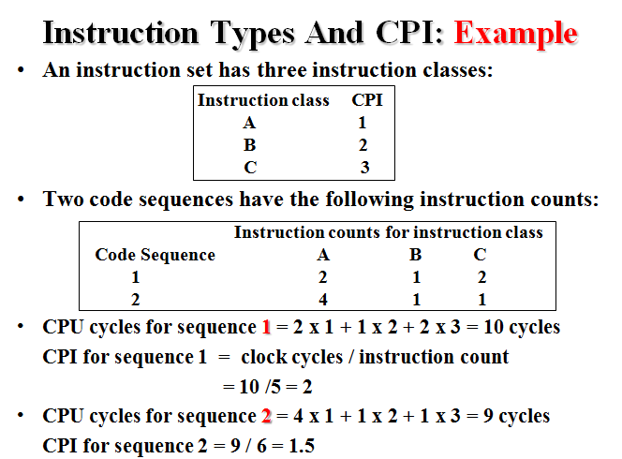

Slide 56
Introduction to Number System and Logic Gates-Topics
Number Systems- Binary, Decimal, Octal, Hexadecimal
Codes- Grey, BCD,Excess-3,
ASCII, Parity
Binary Arithmetic- Addition, Subtraction, Multiplication, Division using Sign Magnitude
1’s compliment, 2’s compliment,
BCD Arithmetic;
Logic Gates-AND, OR, NOT, NAND,
NOR, EX-OR, EX-NOR

Slide 57
Digital System
Takes a set of discrete information inputs and discrete internal information (system state) and generates a set of discrete information outputs.
Discrete
Discrete
Information
Inputs
Discrete
Processing
Outputs
System
System State

Slide 58
Types of Digital Systems
No state present
Combinational Logic System
Output = Function(Input)
State present
State updated at discrete times
=> Synchronous Sequential System
State updated at any time
=>Asynchronous Sequential System
State = Function (State, Input)
Output = Function (State) or Function (State, Input)

Slide 59
Digital System Example
A Digital Counter (e. g., odometer):
Count Up
0
0
1
3
5
6
4
Reset
Inputs:
Count Up, Reset
Outputs:
Visual Display
State:
"Value" of stored digits
Synchronous or Asynchronous?

Slide 60
A Digital Computer Example
Inputs: Keyboard, mouse, modem, microphone
Outputs: CRT, LCD, modem, speakers
Synchronous or Asynchronous?
Notes:
Answer: Part of specification for a PC is in MHz. What does that imply? A clock which defines the discrete times for update of state for a synchronous system. Not all of the computer may be synchronous, however.

Slide 61
Signal
An information variable represented by physical quantity.
For digital systems, the variable takes on discrete values.
Two level, or binary values are the most prevalent values in digital systems.
Binary values are represented abstractly by:
digits 0 and 1
words (symbols) False (F) and True (T)
words (symbols) Low (L) and High (H)
and words On and Off.
Binary values are represented by values or ranges of values of physical quantities

Slide 62
Signal Examples Over Time
Time
Continuous in value & time
Analog
Digital
Discrete in value & continuous in time
Asynchronous
Synchronous
Discrete in value & time

Slide 63
Binary Values: Other Physical Quantities
What are other physical quantities represent 0 and 1?
CPU Voltage
Disk
CD
Dynamic RAM
Magnetic Field Direction
Surface Pits/Light
Electrical Charge

Slide 64
Number Systems – Representation
Positive radix, positional number systems
A number with radix r is represented by a string of digits: A_{n - 1}A_{n - 2} … A₁A₀ . A₋ ₁ A₋ ₂ … A_{- m + 1} A_{- m} in which 0 ≤ A_{i} < r and . is the radix point.
The string of digits represents the power series:
(
)
(
)
i = n - 1
j = - 1
(Number)_{r}
=
∑
i
+
∑
j
A
r
A
r
i
j
i = 0
j = - m
(Integer Portion)
(Fraction Portion)
+

Slide 65
Number Systems – Examples
 | General | Decimal | Binary
Radix (Base) | r | 10 | 2
Digits | 0 => r - 1 | 0 => 9 | 0 => 1
0 1 2 3 Powers of 4 Radix 5 -1 -2 -3 -4 -5 | r⁰ r¹ r² r³ r⁴ r⁵ r ⁻¹ r ⁻² r ⁻³ r ⁻⁴ r ⁻⁵ | 1 10 100 1000 10,000 100,000 0.1 0.01 0.001 0.0001 0.00001 | 1 2 4 8 16 32 0.5 0.25 0.125 0.0625 0.03125

Slide 66
Special Powers of 2
2¹⁰ (1024) is Kilo, denoted "K"
2²⁰ (1,048,576) is Mega, denoted "M"
2³⁰ (1,073, 741,824)is Giga, denoted "G"

Slide 67
Positive Powers of 2
Useful for Base Conversion
Exponent
Value
Exponent
Value
0
1
11
2,048
1
2
12
4,096
2
4
13
8,192
3
8
14
16,384
4
16
15
32,768
5
32
16
65,536
6
64
17
131,072
7
128
18
262,144
8
256
19
524,288
9
512
20
1,048,576
10
1024
21
2,097,152

Slide 68
Converting Binary to Decimal
To convert to decimal, use decimal arithmetic to form Σ (digit × respective power of 2).
Example:Convert 11010₂ to N₁₀:
Notes:
Powers of 2: 43210
11010₂ =>
1 X 2⁴ = 16
+ 1 X 2³ = 8
+ 0 X 2² = 0
+ 1 X 2¹ = 2
+ 0 X 2⁰ = 0
26₁₀

Slide 69
Converting Decimal to Binary
Method 1
Subtract the largest power of 2 (see slide 14) that gives a positive remainder and record the power.
Repeat, subtracting from the prior remainder and recording the power, until the remainder is zero.
Place 1’s in the positions in the binary result corresponding to the powers recorded; in all other positions place 0’s.
Example: Convert 625₁₀ to N₂
Notes:
625 – 512 = 113 => 9
113 – 64 = 49 => 6
49 – 32 = 17 => 5
17 – 16 = 1 => 4
1 – 1 = 0 => 0
Placing 1’s in the result for the positions recorded and 0’s elsewhere,
9 8 7 6 5 4 3 2 1 0
1 0 0 1 1 1 0 0 0 1

Slide 70
Commonly Occurring Bases
Name
Radix
Digits
Binary
2
0,1
Octal
8
0,1,2,3,4,5,6,7
Decimal
10
0,1,2,3,4,5,6,7,8,9
Hexadecimal
16
0,1,2,3,4,5,6,7,8,9,A,B,C,D,E,F
The six letters (in addition to the 10
integers) in hexadecimal represent:
Notes:
Answer: The six letters A, B, C, D, E, and F represent the digits for values
10, 11, 12, 13, 14, 15 (given in decimal), respectively, in hexadecimal.
Alternatively, a, b, c, d, e, f are used.

Slide 71
Numbers in Different Bases
Good idea to memorize!
Decimal
Binary
Octal
Hexa
decimal
(Base 10)
(Base 2)
(Base 8)
(Base 16)
00
00000
00
00
01
00001
01
01
02
00010
02
02
03
00011
03
03
04
00100
04
04
05
00101
05
05
06
00110
06
06
07
00111
07
07
08
01000
10
08
09
01001
11
09
10
01010
12
0A
11
0101
1
13
0B
12
01100
14
0C
13
01101
15
0D
14
01110
16
0E
15
01111
17
0F
16
10000
20
10

Slide 72
Conversion Between Bases
Method 2
To convert from one base to another:
1) Convert the Integer Part
2) Convert the Fraction Part
3) Join the two results with a radix point

Slide 73
Conversion Details
To Convert the Integral Part:
Repeatedly divide the number by the new radix and save the remainders. The digits for the new radix are the remainders in reverse order of their computation. If the new radix is > 10, then convert all remainders > 10 to digits A, B, …
To Convert the Fractional Part:
Repeatedly multiply the fraction by the new radix and save the integer digits that result. The digits for the new radix are the integer digits in order of their computation. If the new radix is > 10, then convert all integers > 10 to digits A, B, …

Slide 74
Example: Convert 46.6875₁₀ To Base 2
Convert 46 to Base 2
Convert 0.6875 to Base 2:
Join the results together with the radix point:
Notes:
Answer 1: Converting 46 as integral part: Answer 2: Converting 0.6875 as fractional part:
46/2 = 23 rem = 0 0.6875 * 2 = 1.3750 int = 1
23/2 = 11 rem = 1 0.3750 * 2 = 0.7500 int = 0
11/2 = 5 remainder = 1 0.7500 * 2 = 1.5000 int = 1
5/2 = 2 remainder = 1 0.5000 * 2 = 1.0000 int = 1
2/2 = 1 remainder = 0 0.0000
1/2 = 0 remainder = 1 Reading off in the forward direction: 0.1011₂
Reading off in the reverse direction: 101110₂
Answer 3: Combining Integral and Fractional Parts:
101110. 1011₂

Slide 75
Additional Issue - Fractional Part
Note that in this conversion, the fractional part became 0 as a result of the repeated multiplications.
In general, it may take many bits to get this to happen or it may never happen.
Example: Convert 0.65₁₀ to N₂
0.65 = 0.1010011001001 …
The fractional part begins repeating every 4 steps yielding repeating 1001 forever!
Solution: Specify number of bits to right of radix point and round or truncate to this number.

Slide 76
Checking the Conversion
To convert back, sum the digits times their respective powers of r.
From the prior conversion of 46.6875₁₀
101110₂ = 1·32 + 0·16 +1·8 +1·4 + 1·2 +0·1
= 32 + 8 + 4 + 2
= 46
0.1011₂ = 1/2 + 1/8 + 1/16
= 0.5000 + 0.1250 + 0.0625
= 0.6875

Slide 77
A Final Conversion Note
You can use arithmetic in other bases if you are careful:
Example: Convert 101110₂ to Base 10 using binary arithmetic:
Step 1 101110 / 1010 = 100 r 0110
Step 2 100 / 1010 = 0 r 0100
Converted Digits are 0100₂ | 0110₂
or 4 6 ₁₀

Slide 78
Binary Numbers and Binary Coding
Flexibility of representation
Within constraints below, can assign any binary combination (called a code word) to any data as long as data is uniquely encoded.
Information Types
Numeric
Must represent range of data needed
Very desirable to represent data such that simple, straightforward computation for common arithmetic operations permitted
Tight relation to binary numbers
Non-numeric
Greater flexibility since arithmetic operations not applied.
Not tied to binary numbers

Slide 79
Non-numeric Binary Codes
Given n binary digits (called bits), a binary code is a mapping from a set of represented elements to a subset of the 2^{n} binary numbers.
Example: A binary code for the seven colors of the rainbow
Code 100 is not used
Color
Binary Number
Red
000
Orange
001
Yellow
010
Green
011
Blue
101
Indigo
110
Violet
111

Slide 80
Number of Bits Required
Given M elements to be represented by a binary code, the minimum number of bits, n, needed, satisfies the following relationships:
2^{n} > M > 2^{(n – 1)}
n = log₂ M where x , called the ceiling function, is the integer greater than or equal to x.
Example: How many bits are required to represent decimal digits with a binary code?
Notes:
M = 10
Therefore n = 4 since:
2⁴ =16 is ≥ 10 > 2³ = 8
and the ceiling function for log₂ 10 is 4.

Slide 81
Number of Elements Represented
Given n digits in radix r, there are r^{n} distinct elements that can be represented.
But, you can represent m elements, m < r^{n}
Examples:
You can represent 4 elements in radix r = 2 with n = 2 digits: (00, 01, 10, 11).
You can represent 4 elements in radix r = 2 with n = 4 digits: (0001, 0010, 0100, 1000).
This second code is called a "one hot" code.

Slide 82
Binary Codes for Decimal Digits
There are over 8,000 ways that you can chose 10 elements from the 16 binary numbers of 4 bits. A few are useful:
Decimal
8,4,2,1
Excess3
8,4,
-
2,
-
1
Gray
0
0000
0011
0000
0000
1
0001
0100
0111
0100
2
0010
0101
0110
0101
3
0011
0110
0101
0111
4
0100
0111
0100
0110
5
0101
1000
1011
0010
6
0110
1001
1010
0011
7
0111
1010
1001
0001
8
1000
1011
1000
1001
9
1001
1
100
1111
1000

Slide 83
Binary Coded Decimal (BCD)
The BCD code is the 8,4,2,1 code.
This code is the simplest, most intuitive binary code for decimal digits and uses the same powers of 2 as a binary number, but only encodes the first ten values from 0 to 9.
Example: 1001 (9) = 1000 (8) + 0001 (1)
How many “invalid” code words are there?
What are the “invalid” code words?
Notes:
Answer 1: 6
Answer 2: 1010, 1011, 1100, 1101, 1110, 1111

Slide 84
Excess 3 Code and 8, 4, –2, –1 Code
Decimal | Excess 3 | 8, 4, –2, –1
0 | 0011 | 0000
1 | 0100 | 0111
2 | 0101 | 0110
3 | 0110 | 0101
4 | 0111 | 0100
5 | 1000 | 1011
6 | 1001 | 1010
7 | 1010 | 1001
8 | 1011 | 1000
9 | 1100 | 1111
What interesting property is common to these two codes?
Notes:
Answer: Both of these codes have the property that the codes for 0 and 9, 1 and 8, etc. can be obtained from each other by replacing the 0’s with the 1’s and vice-versa in the code words. Such a code is sometimes called a complement code.

Slide 85
Gray Code
Gray code is the arrangement of binary number system such that each incremental value can only differ by one bit.
This code is also known as Reflected Binary Code (RBC), Cyclic Code and Reflected Binary (RB). The reason for calling this code as reflected binary code is the first N/2 values compared with those of the last N/2 values in reverse order.
In gray code when transverse from one step to another step the only one bit will be change of the group. This means that the two adjacent code numbers differ from each other by only one bit.
It is popular for unit distance code but it is not use from arithmetic operations. This code has some application like convert analog to digital, error correction in digital communication.

Slide 86
Binary- Gray code conversion
STEPS
The most significant bit of gray code is equal to the first bit of the given binary bit.
The second bit of gray code will be exclusive-or (XOR) of the first and second bit of the given binary bit.
The third bit of gray code is equal to the exclusive-or (XOR) of the second and third binary bits. For father gray code result this process will be continuing.

Slide 87

Explanation
Truth Table of XOR
A | B | C
0 | 0 | 0
0 | 1 | 1
1 | 0 | 1
1 | 1 | 0
The given binary digit is 01001
0 1 0 0 1 (Binary)
MSB
LSB
Gray code Conversion
0, 0 1, 1 0,0 0, 0 1
0 , 1 , 1 , 0 , 1 (On concatening)
The gray code of the given binary code (01001) =0 1 1 0 1 (One bit changed)

Slide 88
Example
The gray code of the given binary code is (010.01)2 ??
The first MSB bit of binary is same in the first bit of gray code. In this example the binary bit is “0”. So, gray bit also “0”.
Next gray bit is equal to the XOR of the first and the second binary bit. The first bit is 0, and the second bit is 1. The bits are different so resultant gray bit will be “1” (second gray codes bit)
The XOR of the second and third binary bit. The second bit is 1 and third is 0. These bits are again different so the resultant gray bit will be 1 (third gray codes bit)
Next we perform the XOR operation on third and fourth binary bit. The third bit is 0, and the fourth bit is 0. The both bits are same than resultant gray codes will be 0 (fourth gray codes bit).
Take the XOR of the fourth and fifth binary bit. The fourth bit is 0 and fifth bit is 1. These bits are different than resultant gray codes will be 1 (fifth gray code bit)
The result of binary to gray codes conversion is 01101.

Slide 89
GRAY CODE TABLE The conversion in between decimal to gray and binary to gray code is given below
:
Decimal Number | Binary Number | Gray Code
0 | 0000 | 0000
1 | 0001 | 0001
2 | 0010 | 0011
3 | 0011 | 0010
4 | 0100 | 0110
5 | 0101 | 0111
6 | 0110 | 0101
7 | 0111 | 0100
8 | 1000 | 1100
9 | 1001 | 1101
10 | 1010 | 1111
11 | 1011 | 1110
12 | 1100 | 1010
13 | 1101 | 1011
14 | 1110 | 1001
15 | 1111 | 1000
The gray code of the given binary code
(01001) =0 1 1 0 1. We can see one bit change in the next incremental value.

Slide 90
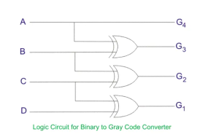
You can convert n bit (b_{n}b_{(n-1)}…b₂b₁b₀) binary number to gray code (g_{n}g_{(n-1)}…g₂g₁g₀). For most significant bit b_{n}=g_{n}, and rest of the bit by XORing b_{(n-1)}=g_{(n-1)}⊕g_{n}, ….

Slide 91
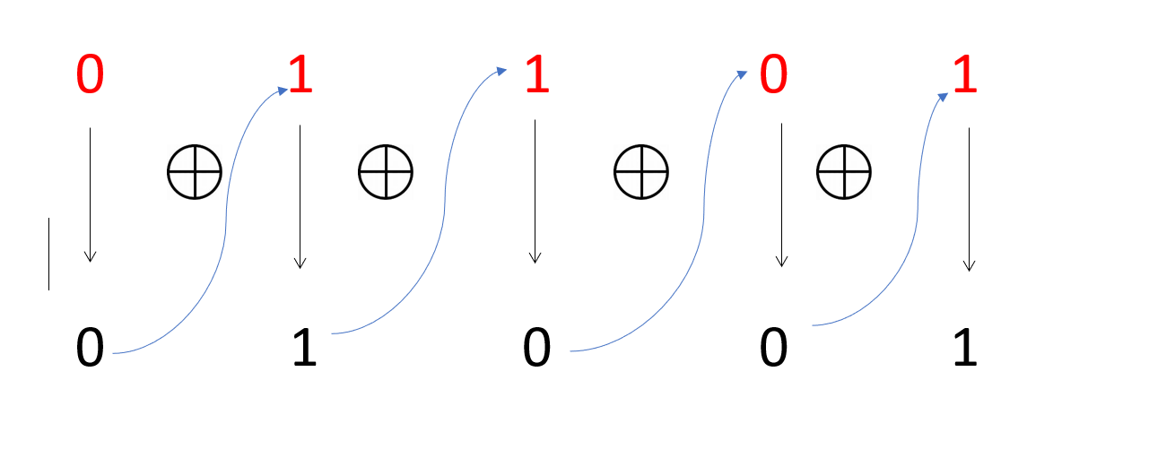
Explanation
Truth Table of XOR
A | B | C
0 | 0 | 0
0 | 1 | 1
1 | 0 | 1
1 | 1 | 0
The given gray code is 01101
0 1 1 0 1 (Gray)
MSB
LSB
Binary code Conversion

Slide 92
Gray-Binary code conversion
Steps
The most significant bit of gray codes is equal in binary number.
Now move to the next gray bit, as it is 1 the previous bit will be alter i.e it will be 1, thus the second binary bit will be 1.
Next see the third bit, in this example the third bit is 1 again, the third binary bit will be alter of second binary bit and the third binary bit will be 0.
Now fourth bit of the, here the fourth bit of gray code is 0. So the fourth bit will be same as a previous binary bit, i.e 4th binary bit will be 0.
The last fifth bit of gray codes is 1; the fifth binary number is altering of fourth binary number.
Therefore the gray code (01101) equivalent in binary number is (01001)

Slide 93
Merits & Demerits of Gray Code
Advantages of gray code
It is best for error minimization in conversion of analog to digital signals.
It is best for minimize a logic circuit
Decreases the “Hamming Walls” which is undesirable state, when used in genetic algorithms
It is useful in clock domain crossing
Disadvantages of gray code
Not suitable for arithmetic operations
It has limited use.

Slide 94
BCD
Binary Coded Decimal, or BCD, is another process for converting decimal numbers into their binary equivalents.
It is a form of binary encoding where each digit in a decimal number is represented in the form of bits.
This encoding can be done in either 4-bit or 8-bit (usually 4-bit is preferred).
It is a fast and efficient system that converts the decimal numbers into binary numbers as compared to the existing binary system.
In short, it is the conversion of decimal to binary digit in 4 –bit scale using 8,4,2,1

Slide 95
Truth table of BCD
Decimal | BCD
 | 8 | 4 | 2 | 1
0 | 0 | 0 | 0 | 0
1 | 0 | 0 | 0 | 1
2 | 0 | 0 | 1 | 0
3 | 0 | 0 | 1 | 1
4 | 0 | 1 | 0 | 0
5 | 0 | 1 | 0 | 1
6 | 0 | 1 | 1 | 0
7 | 0 | 1 | 1 | 1
8 | 1 | 0 | 0 | 0
9 | 1 | 0 | 0 | 1

Slide 96
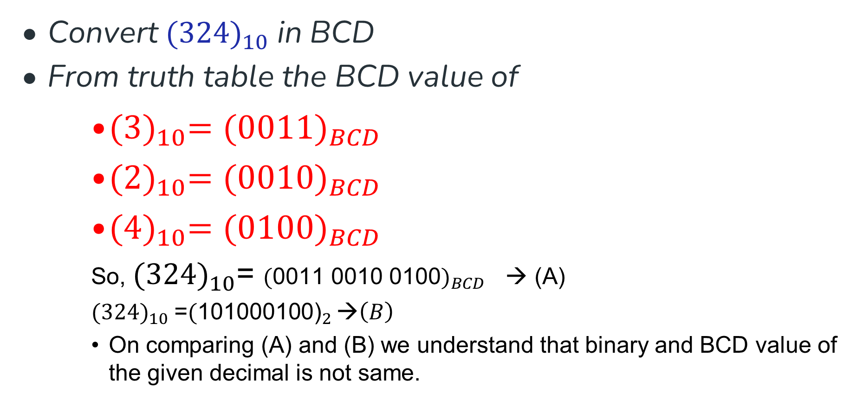
Decimal to BCD
Convert ${(324)}_{10}$ in BCD
From truth table the BCD value of
${(3)}_{10}={(0011)}_{BCD}$
${(2)}_{10}={(0010)}_{BCD}$
${(4)}_{10}={(0100)}_{BCD}$
So, ${(324)}_{10}$= ${(\text{0011 0010 0100})}_{BCD}$ → (A)
${(324)}_{10}$=${(\text{101000100}\text{)}}_{2 }\text{→}\left(B\right)$
On comparing (A) and (B) we understand that binary and BCD value of the given decimal is not same.

Slide 97
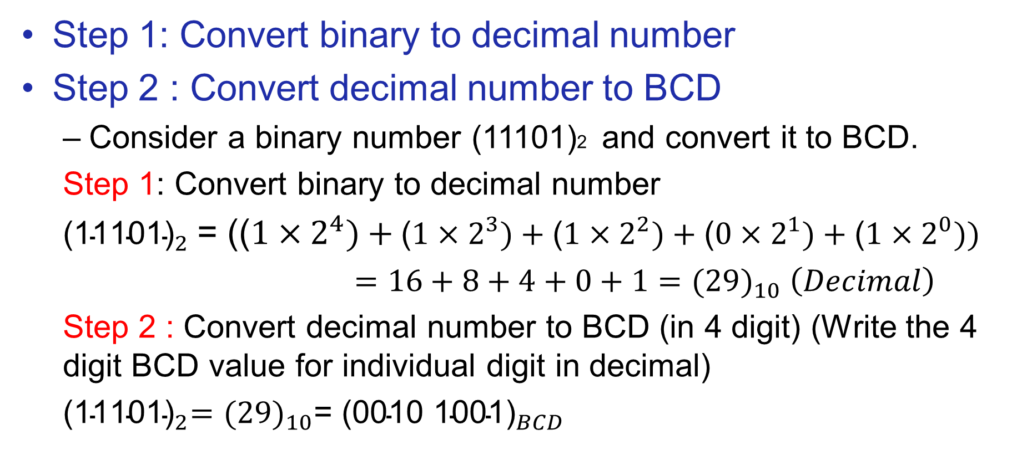
Binary to BCD conversion
Step 1: Convert binary to decimal number
Step 2 : Convert decimal number to BCD
Consider a binary number (11101)2 and convert it to BCD.
Step 1: Convert binary to decimal number
${\text{(}\text{11101}\text{)}}_{2}$= (($1×2^{4})+\text{(}1×2^{3})+\text{(}1×2^{2})+\text{(}0×2^{1})+\text{(}1×2^{0}))$
$=16+8+4+0+1={(29)}_{10} \left(Decimal\right)$
Step 2 : Convert decimal number to BCD (in 4 digit) (Write the 4 digit BCD value for individual digit in decimal)
${{\text{(}\text{11101}\text{)}}_{2}=(29)}_{10}$= ${\text{(}\text{0010 1001}\text{)}}_{BCD}$

Slide 98
Advantages of BCD
Easy to encode and Decode decimals into BCD and Vice-versa
Easy to implement a hardware algorithm for BCD converter
Very useful in digital systems whenever decimal information reqd.
Digital voltmeters, frequency converters and digital clocks all use BCD as they display output information in decimal.

Slide 99
Disadvantages of BCD Code
Require more bits than straight binary code
Difficult to be used in high speed digital computer when the size and capacity of their internal registers are restricted or limited.
The arithmetic operations using BCD code require a complex design of Arithmetic and Logic Unit (ALU) than the straight binary number system.
The speed of the arithmetic operations that can be realized using BCD code is naturally slow due to the complex hardware circuitry involved.

Slide 100
Excess-3 code
The excess-3 code is also treated as XS-3 code. The excess-3 code is a non-weighted and self-complementary BCD code used to represent the decimal numbers.
This code has a biased representation. This code plays an important role in arithmetic operations because it resolves deficiencies encountered when we use the 8421 BCD code for adding two decimal digits whose sum is greater than 9.
The Excess-3 code uses a special type of algorithm, which differs from the binary positional number system or normal non-biased BCD.

Slide 101
Decimal to Excess-3 code conversion
Step-1: We find the decimal number of the given binary number. Step-2: Then we add 3 in each digit of the decimal number.
Step-3: Now, we find the binary code of each digit of the newly generated decimal number.
Alternatively,
We can also add 0011 in each 4-bit BCD code of the decimal number for getting excess-3 code.

Slide 102
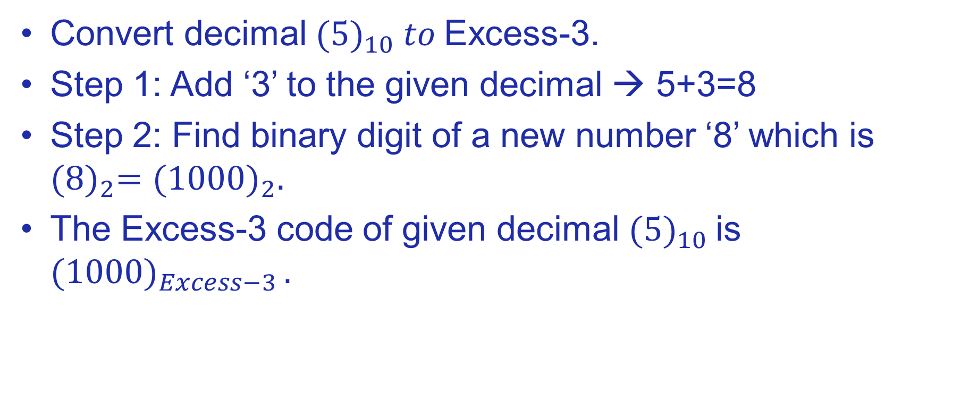
Ex-1
Convert decimal ${(5)}_{10} to$Excess-3.
Step 1: Add ‘3’ to the given decimal → 5+3=8
Step 2: Find binary digit of a new number ‘8’ which is ${(8)}_{2}={(1000)}_{2}.$
The Excess-3 code of given decimal ${(5)}_{10}$is ${(1000)}_{Excess−3 }.$

Slide 103
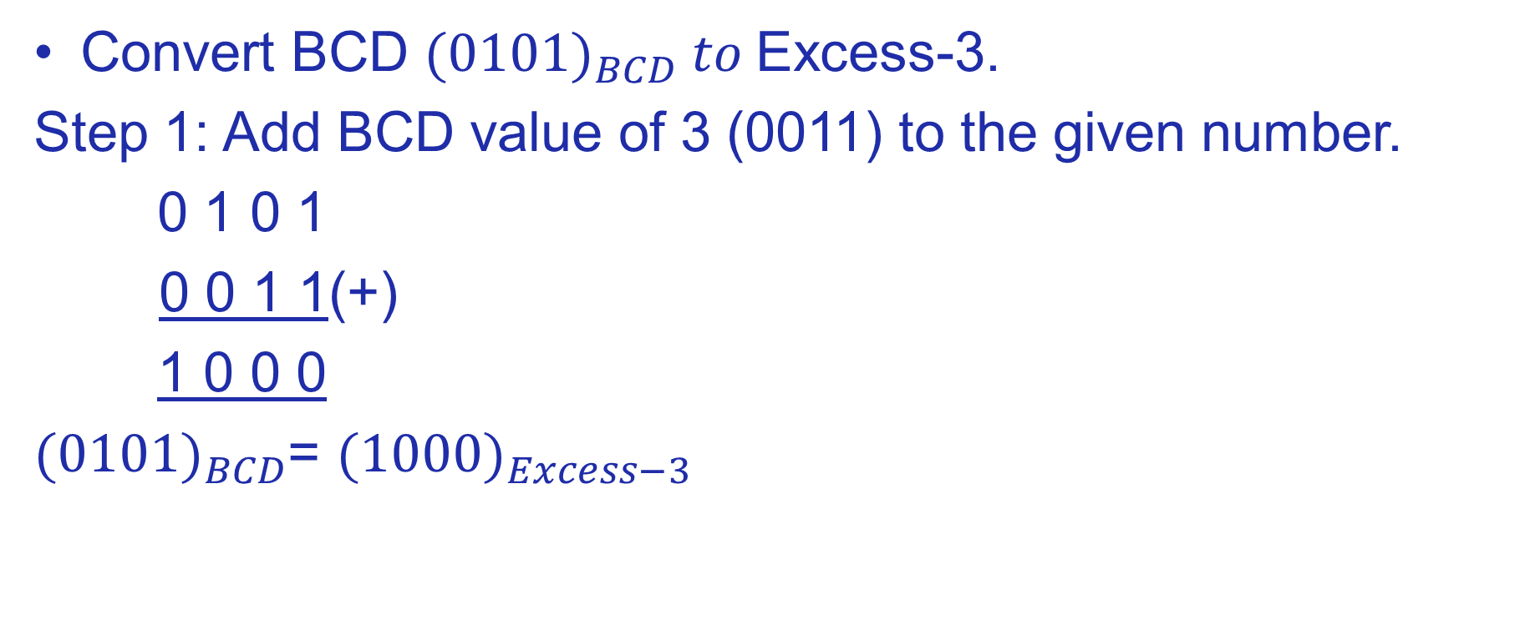
Ex-2
Convert BCD ${(0101)}_{BCD} to$Excess-3.
Step 1: Add BCD value of 3 (0011) to the given number.
0 1 0 1
0 0 1 1(+)
1 0 0 0
${(0101)}_{BCD}$= ${(1000)}_{Excess−3 }$

Slide 104
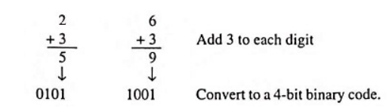
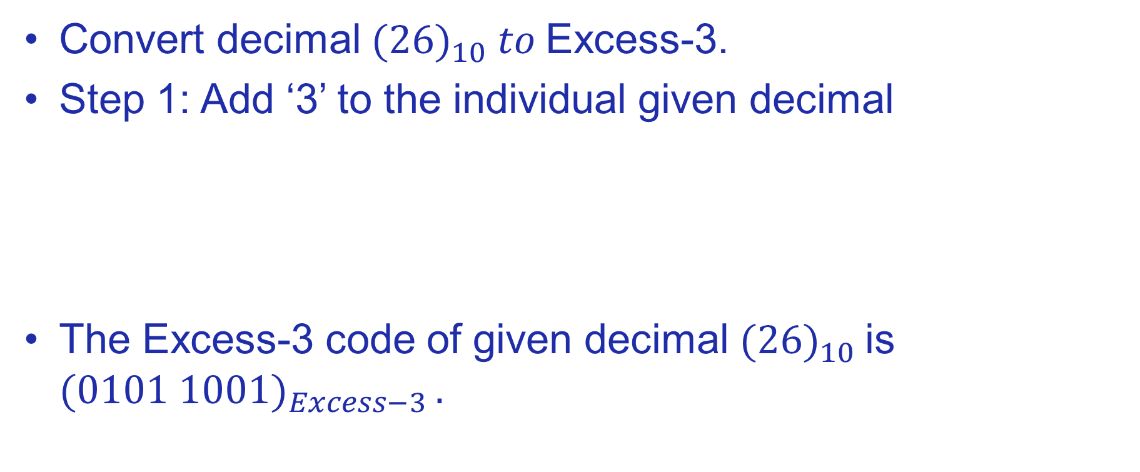
Ex-3
Convert decimal ${(26)}_{10} to$Excess-3.
Step 1: Add ‘3’ to the individual given decimal
The Excess-3 code of given decimal ${(26)}_{10}$is ${(0101 1001)}_{Excess−3 }.$

Slide 105
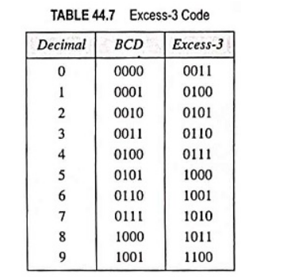
Excess-3 code

Slide 106

Ex-4
Convert decimal ${(81.61)}_{10} to$Excess-3.
Step 1: Step 2:
Decimal
BCD
$${(81.61)}_{10}{=(1011 0100.1001 0100)}_{Excess−3}$$
Decimal | BCD
8 | 1000
1 | 0001
6 | 0110
1 | 0001
BCD+ 0011 | Excess-3
1000+0011 | 1011
0001+0011 | 0100
0110+0011 | 1001
0001+0011 | 0100

Slide 107
Ex 5
Convert (11110)₂ to Excess-3 using binary
Step 1: Convert binary to Decimal. (11110)₂ = (30)₁₀
Step 2: Add ‘3’ to individual digits to decimal number
3 0
3 3
6 3
Step 3: Find binary values of (63)10 = (01100011)_{Excess-3}

Slide 108
Ex 6
Convert (01100011) _{Excess-3} to binary.
Step- 1 : Find the decimal by dividing it four digits
(01100011) _{Excess-3} = (0110 0011) _{Excess-3} = (30) 10
Step-2 : Find the binary value of the decimal thorugh division method.
(01100011) _{Excess-3} = (11110)2

Slide 109
Advantages
These codes are self-complementary.
These codes use biased representation.
The excess-3 code has no limitation, so that it considerably simplifies arithmetic operations.
The codes 0000 and 1111 can cause a fault in the transmission line. The excess-3 code doesn't use these codes and gives an advantage for memory organization.
These codes are usually unweighted binary decimal codes.
This code has a vital role in arithmetic operations. It is because it resolves deficiencies which are encountered when we use the 8421 BCD code for adding two decimal digits whose sum is greater than 9.

Slide 110
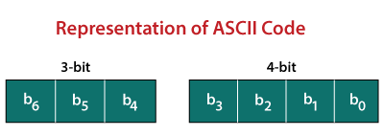
ASCII
The ASCII stands for American Standard Code for Information Interchange. The ASCII code is an alphanumeric code used for data communication in digital computers.
The ASCII is a 7-bit code capable of representing 2⁷ or 128 number of different characters. The ASCII code is made up of a three-bit group, which is followed by a four-bit code.

Slide 111
ASCII Characters
Control Characters-0 to 31 and 127
Special Characters- 32 to 47, 58 to 64, 91 to 96, and 123 to 126
Numbers Characters- 0 to 9
Letters Characters - 65 to 90 and 97 to 122
ASCII Character Set

Slide 112
Ex 1
Encode (10010101100001111011011000011010100111000011011111101001 110111011101001000000011000101100100110011)₂ to ASCII.

Slide 113
Step 1:
The given binary data is grouped into 7-bits because the ASCII code is 7 bit.
1001010 1100001 1110110 1100001 1010100 1110000 1101111 1101001 1101110 1110100 1000000 0110001 0110010 0110011
Step 2:
Then, we find the equivalent decimal number of the binary digits either from the ASCII table or 64 32 16 8 4 2 1 scheme.

Slide 114
Cont’d
Binary | 64 | 32 | 16 | 8 | 4 | 2 | 1 | DECIMAL | ASCII
1100011 | 1 | 1 | 0 | 0 | 0 | 1 | 1 | 99 | C
1101111 | 1 | 1 | 0 | 1 | 1 | 1 | 1 | 111 | O
1101101 | 1 | 1 | 0 | 1 | 1 | 0 | 1 | 109 | M
1110000 | 1 | 1 | 1 | 0 | 0 | 0 | 0 | 112 | P
1110101 | 1 | 1 | 1 | 0 | 1 | 0 | 1 | 117 | U
1110100 | 1 | 1 | 1 | 0 | 1 | 0 | 0 | 116 | T
1100101 | 1 | 1 | 0 | 0 | 1 | 0 | 1 | 101 | E
1110010 | 1 | 1 | 1 | 0 | 0 | 1 | 0 | 114 | R
So the given binary digits results in ASCII Keyword COMPUTER

Slide 115
Parity Code
The parity code is used for the purpose of detecting errors during the transmission of binary information. The parity code is a bit that is included with the binary data to be transmitted.
The inclusion of a parity bit will make the number of 1’s either odd or even. Based on the number of 1’s in the transmitted data, the parity code is of two types.
Even parity code
Odd parity code

Slide 116
In even parity, the added parity bit will make the total number of 1’s an even number.
If the added parity bit make the total number of 1’s as odd number, such parity code is said to be odd parity code.

Slide 117
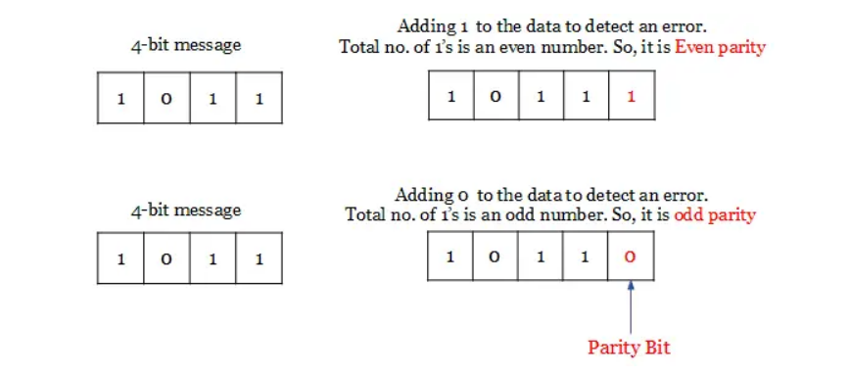
Explanation

Slide 118
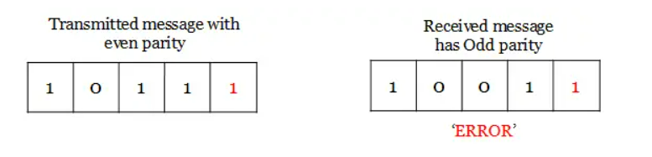
On the receiver side, if the received data is other than the sent data, then it is an error. If the sent date is even parity code and the received data is odd parity, then there is an error.
So, both even and odd parity codes are used only for the detection of error and not for the correction in the transmitted data. Even parity is commonly used and it has almost become a convention.

Slide 119
Advantages
Easy to implement
Simple method
Used error detection
Demerits
No error correction

Slide 120
Warning: Conversion or Coding?
Do NOT mix up conversion of a decimal number to a binary number with coding a decimal number with a BINARY CODE.
13₁₀ = 1101₂ (This is conversion)
13 ⇔ 0001|0011 (This is coding)

Slide 121
Binary Arithmetic
Single Bit Addition with Carry
Multiple Bit Addition
Single Bit Subtraction with Borrow
Multiple Bit Subtraction
Multiplication
BCD Addition

Slide 122
Multiple Bit Binary Addition
Extending this to two multiple bit examples:
Carries 0 0
Augend 01100 10110
Addend +10001 +10111
Sum
Note: The 0 is the default Carry-In to the least significant bit.
Notes:
Carries 00000 01100
Augend 01100 10110
Addend +10001 +10111
Sum 11101 101101

Slide 123
Single Bit Binary Subtraction with Borrow
Given two binary digits (X,Y), a borrow in (Z) we get the following difference (S) and borrow (B):
Borrow in (Z) of 0:
Borrow in (Z) of 1:
Z
0
0
0
0
X
0
0
1
1
- Y
-0
-1
-0
-1
BS
0 0
1 1
0 1
0 0
Z
1
1
1
1
X
0
0
1
1
- Y
-0
-1
-0
-1
BS
11
1 0
0 0
1 1

Slide 124
Multiple Bit Binary Subtraction
Extending this to two multiple bit examples:
Borrows 0 0
Minuend 10110 10110
Subtrahend - 10010 - 10011
Difference
Notes: The 0 is a Borrow-In to the least significant bit. If the Subtrahend > the Minuend, interchange and append a – to the result.
Notes:
Borrows 00000 00110
Minuend 10110 10110
Subtrahend –10010 –10011
Difference 00100 00011

Slide 125
Binary Multiplication

Slide 126
BCD Arithmetic
Given a BCD code, we use binary arithmetic to add the digits:
8
1000
Eight
+5
+0101
Plus 5
13
1101
is 13 (> 9)
Note that the result is MORE THAN 9, so must be represented by two digits!
To correct the digit, subtract 10 by adding 6 modulo 16.
8
1000
Eight
+5
+0101
Plus 5
13
1101
is 13 (> 9)
+0110
so add 6
carry = 1
0011
leaving 3 + cy
0001 | 0011
Final answer (two digits)
If the digit sum is > 9, add one to the next significant digit

Slide 127
BCD Addition Example
Add 2905_{BCD} to 1897_{BCD} showing carries and digit corrections.
0
0001 1000 1001 0111
+ 0010 1001 0000 0101
Notes:
1 1 1 0
0001 1000 1001 0111
+ 0010 1001 0000 0101
0100 10010 1010 1100
+ 0000+ 0110+ 0110+ 0110
0100 1000 0000 0010

Slide 128

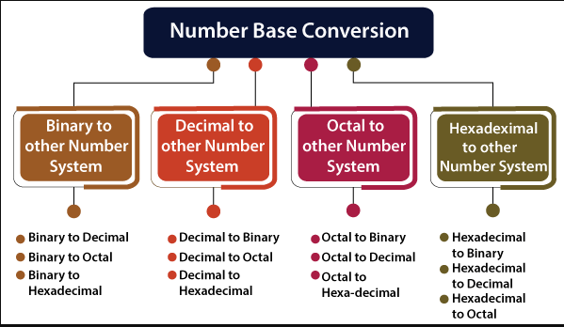
Number System

Slide 129
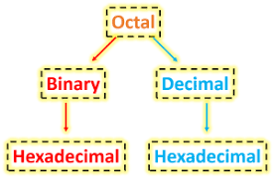
Octal Number System
Octal to Binary
Octal to Decimal
Octal to Hexadecimal

Slide 130
Octal to Binary
Octal number is one of the number systems which has value of base is 8, that means there only 8 symbols − 0, 1, 2, 3, 4, 5, 6, and 7.
Whereas Binary number is most familiar number system to the digital systems, networking, and computer professionals.

Slide 131
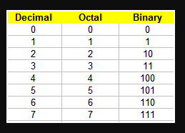
Octal to Binary Equivalent Table

Slide 132
Octal to Binary
This method is simple and also works as reverse of Binary to Octal Conversion. The algorithm is explained as following below.
Take Octal number as input
Convert each digit of octal into binary.
That will be output as binary number.

Slide 133
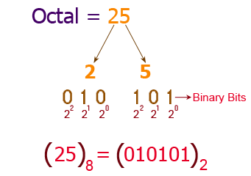
Octal to Binary
Example-1 Convert octal number 25 into binary number.

Slide 134
Octal to Binary
Example-2 Convert octal number 540 into binary number.
According to above algorithm, equivalent binary number will be,
= (540)₈ = (101 100 000)₂ = (101100000)₂

Slide 135
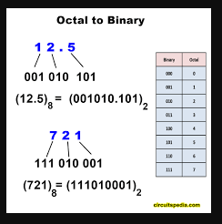
Octal to Binary
Example 3: Convert octal number 12.5 & 721 into binary number.

Slide 136
Octal to Binary
Example 4: Convert octal number 352.563 into binary number.
According to above algorithm, equivalent binary number will be,
= (352.563)₈ = (011 101 010 . 101 110 011)₂ = (011101010.101110011)₂

Slide 137
Octal to Decimal
To convert an octal number to a decimal number we need to multiply each digit of the given octal with the reducing power of 8.
Let us learn here, the conversion of Octal number to Decimal Number or base 8 to base 10.

Slide 138
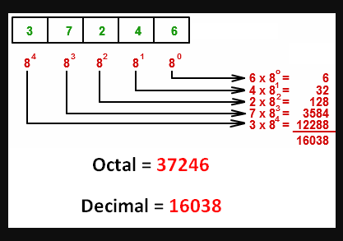
Octal to Decimal
Example 1: Convert octal number 37246₍₈₎ into decimal form.

Slide 139
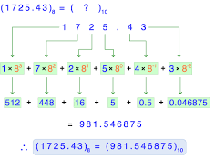
Octal to Decimal
Example 2: Convert octal number 1725.43₍₈₎ into decimal form.

Slide 140
Octal to Decimal
Example 3: Convert octal number 7.12172₍₈₎ into decimal form.
= 7x8⁰ + 1x8⁻¹ + 2x8⁻² + 1x8⁻³ + 7x8⁻⁴ + 2x8⁻⁵
= 7 + 0.125 + 0.03125 + 0.001953125 + 0.001708984375 + 0.00006103515624
= 10.1599

Slide 141
Octal to Hexadecimal
First turning the octal number into a
1. Binary Digit
2. binary to Hexadecimal

Slide 142
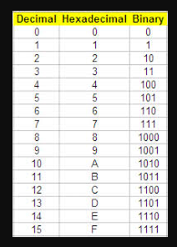
Octal to Hexadecimal

Slide 143
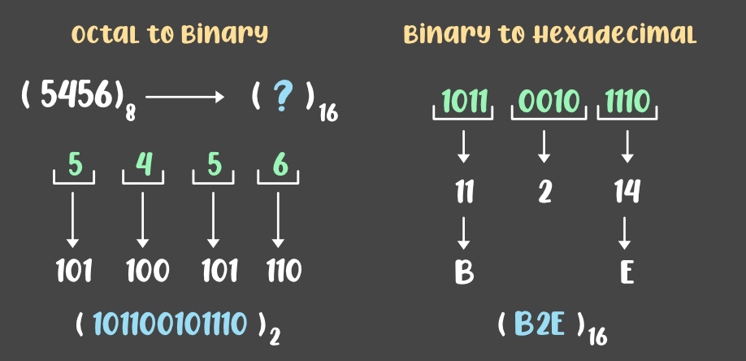
Octal to Hexadecimal
Example 1: Convert octal number 5456 ₍₈₎ into hexadecimal form.

Slide 144
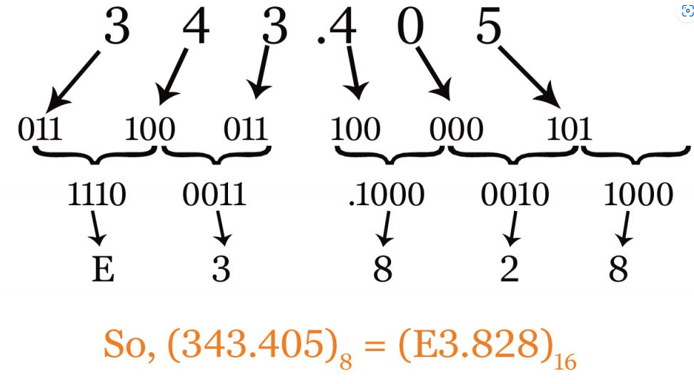
Octal to Hexadecimal
Example 2: Convert octal number 343.405₍₈₎ into hexadecimal form.

Slide 145
Hexadecimal Number System
Hexadecimal to Binary
Hexadecimal to decimal
Hexadecimal to octal

Slide 146
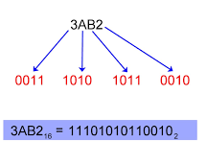
Hexadecimal to Binary
Example 1: Convert hexadecimal number BAB2 ₍₁₆₎ into binary form.

Slide 147
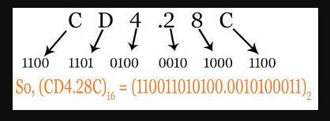
Hexadecimal to Binary
Example 2: Convert hexadecimal number CD4.28C ₍₁₆₎ into binary form.

Slide 148
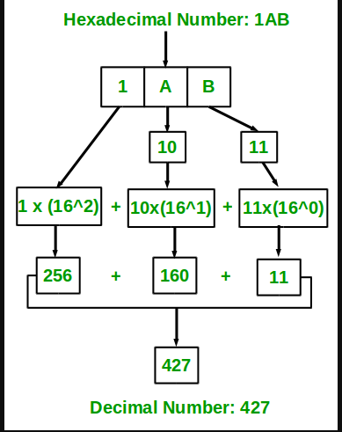
Hexadecimal to decimal
Example 1: Convert hexadecimal number 1AB ₍₁₆₎ into decimal form.

Slide 149
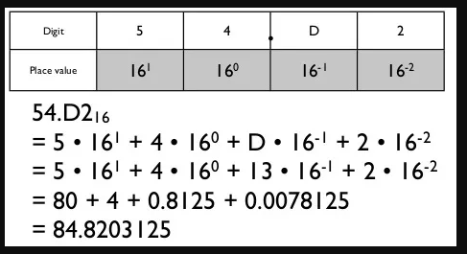
Hexadecimal to decimal
Example 2: Convert hexadecimal number 54.D2 ₍₁₆₎ into decimal form.

Slide 150
Hexadecimal to octal
First turning the hexadecimal number into a
1. Binary Number
2. binary to octal

Slide 151
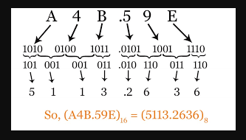
Hexadecimal to octal
Example 1: Convert hexadecimal number A4B.59E ₍₁₆₎ into decimal form.

Slide 152
Signed Binary Numbers
Two ways of representing signed numbers:
1) Sign-magnitude form, 2) Complement form.
Most of computers use complement form for negative number notation.
1’s complement and 2’s complement are two different methods in this type.

Slide 153
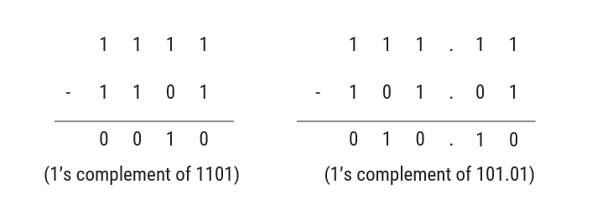
1’s Complement
1’s complement of a binary number is obtained by subtracting each digit of that binary number from 1.
Example
Shortcut: Invert the numbers from 0 to 1 and 1 to 0

Slide 154
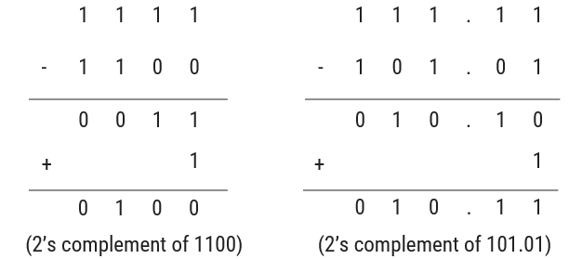
2’s Complement
2’s complement of a binary number is obtained by adding 1 to its 1’s complement.
Example
Shortcut: Starting from right side, all bits are same till first 1 occurs and then invert rest of the bits

Slide 155
Subtraction using 1’s complement
Using 1’s complement
Obtain 1’s complement of subtrahend
Add the result to minuend and call it intermediate result
If carry is generated then answer is positive and add the carry to Least Significant Digit (LSD)
If there is no carry then answer is negative and take 1’s complement of intermediate result and place negative sign to the result.

Slide 156
Subtraction using 2’s complement
Using 2’s complement
Obtain 2’s complement of subtrahend
Add the result to minuend
If carry is generated then answer is positive, ignore carry and result itself is answer
If there is no carry then answer is negative and take 2’s complement of intermediate result and place negative sign to the result.

Slide 157
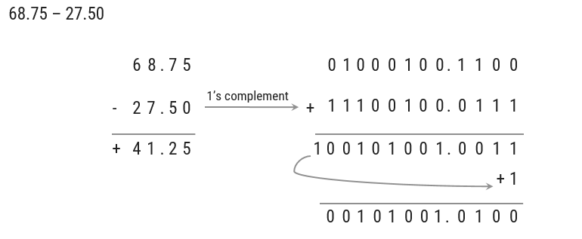
Subtraction using 1’s complement (Examples)
Example - 1

Slide 158
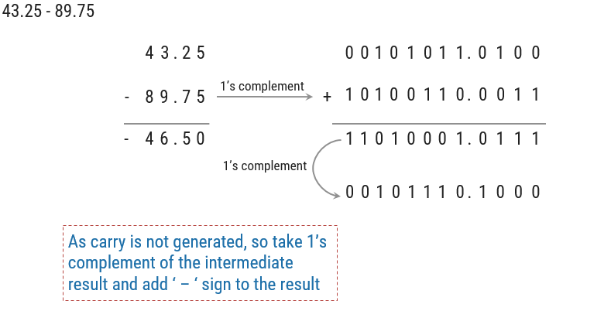
Subtraction using 1’s complement (Examples)
Example - 2

Slide 159
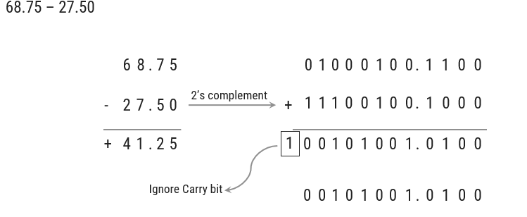
Subtraction using 2’s complement (Examples)
Example - 1

Slide 160
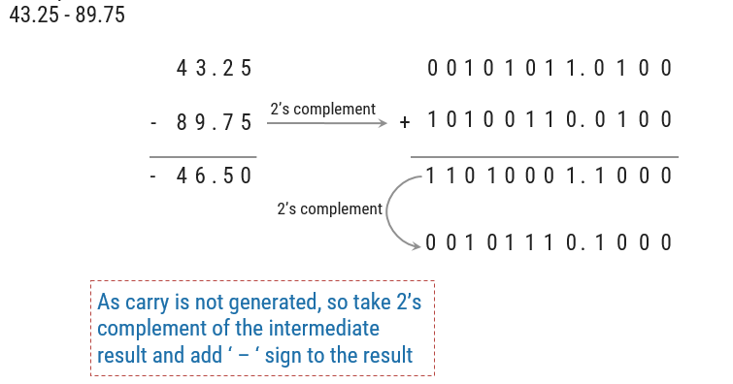
Subtraction using 2’s complement (Examples)
Example - 2

Slide 161
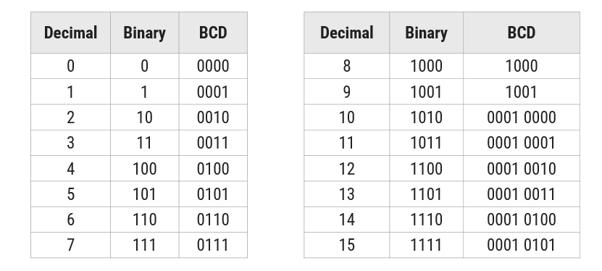
Binary Codes

Slide 162
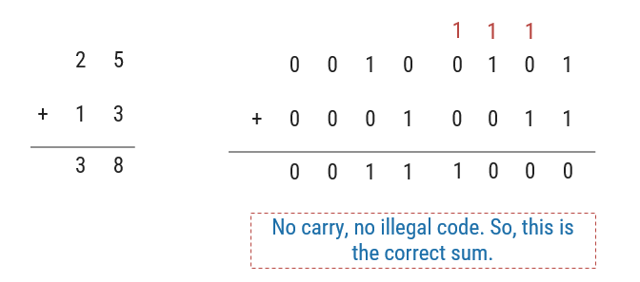
BCD Addition
Example - 1
Rule: If there is an illegal code or carry is generated as a result of addition, then add 0110 to particular that 4 bits of result.

Slide 163
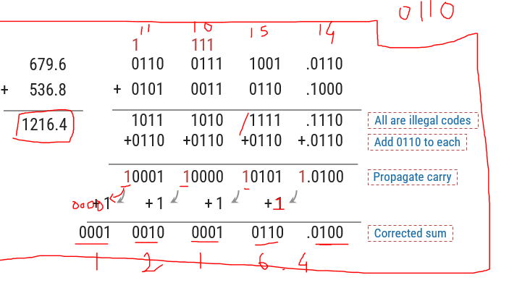
BCD Addition
Example - 2

Slide 164

BCD Subtraction
Example - 1
Rule: If one 4-bit group needs to take borrow from neighbor, then subtract 0110 from the group which is receiving borrow.

Slide 165

BCD Subtraction
Example - 2

Slide 166
ASCII Character Codes
American Standard Code for Information Interchange
This code is a popular code used to represent information sent as character-based data. It uses 7-bits to represent:
94 Graphic printing characters.
34 Non-printing characters
Some non-printing characters are used for text format (e.g. BS = Backspace, CR = carriage return)
Other non-printing characters are used for record marking and flow control (e.g. STX and ETX start and end text areas).
(Refer to Table 1
-4 in the text)

Slide 167
ASCII Properties
ASCII has some interesting properties:
Digits 0 to 9 span Hexadecimal values 30₁₆
to 39₁₆
.
Upper case A
-
Z span 41₁₆
to 5A₁₆
.
Lower case a
-
z span 61₁₆
to 7A₁₆
.
Lower to upper case translation (and vice versa)
occurs by
flipping bit 6.
Delete (DEL) is all bits set,
a carryover from when
punched paper tape was used to store messages.
Punching all holes in a row erased a mistake!

Slide 168
UNICODE
UNICODE extends ASCII to 65,536 universal characters codes
For encoding characters in world languages
Available in many modern applications
2 byte (16-bit) code words

Slide 169
Logic Gates
Goal:
To understand how digital a computer can work, at the lowest level.
To understand what is possible and the limitations of what is possible for a digital computer.

Slide 170
Logic Gates
All digital computers for the past 50 years have been constructed using the same type of components.
These components are called logic gates.
Logic gates have been implemented in many different ways.
Currently, logic gates are most commonly implemented using electronic VLSI transistor logic.

Slide 171
Logic Gates
A logic gate is a simple switching circuit that determines whether an input pulse can pass through to the output in digital circuits.
The building blocks of a digital circuit are logic gates, which execute numerous logical operations that are required by any digital circuit.
These can take two or more inputs but only produce one output.
The mix of inputs applied across a logic gate determines its output. Logic gates use Boolean algebra to execute logical processes.
Logic gates are found in nearly every digital gadget we use on a regular basis.
Logic gates are used in the architecture of our telephones, laptops, tablets, and memory devices.

Slide 172

Logic Gates
All basic logic gates have the ability to accept either one or two input signals (depending upon the type of gate) and generate one output signal.

Slide 173
Boolean Algebra
Boolean algebra is a type of logical algebra in which symbols represent logic levels.
The digits(or symbols) 1 and 0 are related to the logic levels in this algebra; in electrical circuits, logic 1 will represent a closed switch, a high voltage, or a device’s “on” state.
An open switch, low voltage, or “off” state of the device will be represented by logic 0.
At any one time, a digital device will be in one of these two binary situations. A light bulb can be used to demonstrate the operation of a logic gate.
When logic 0 is supplied to the switch, it is turned off, and the bulb does not light up.
The switch is in an ON state when logic 1 is applied, and the bulb would light up.
In integrated circuits (IC), logic gates are widely employed.

Slide 174
Contd..
Input and Output signals are binary.
binary:
always in one of two possible states;
typically treated as:
On / Off (electrically)
1 / 0
True / False
There is a delay between when a change happens at a logic gates inputs and when the output changes, called gate switching time.
The True or False view is most useful for thinking about the meaning of the basic logic gates.

Slide 175
Truth Table
The outputs for all conceivable combinations of inputs that may be applied to a logic gate or circuit are listed in a truth table.
When we enter values into a truth table, we usually express them as 1 or 0, with 1 denoting True logic and 0 denoting False logic.

Slide 176

Classification

Slide 177
Basic Logic Gates-
Basic Logic Gates are the fundamental logic gates using which universal logic gates and other logic gates are constructed.
They have the following properties-
Basic logic gates are associative in nature.
Basic logic gates are commutative in nature.
There are following three basic logic gates-
AND Gate
OR Gate
NOT Gate

Slide 178
AND gate
The output of AND gate is high (‘1’) if all of its inputs are high (‘1’).
The output of AND gate is low (‘0’) if any one of its inputs is low (‘0’).

Slide 179

Logic Symbol

Slide 180

Truth Table

Slide 181
OR Gate
The output of OR gate is high (‘1’) if any one of its inputs is high (‘1’).
The output of OR gate is low (‘0’) if all of its inputs are low (‘0’).

Slide 182

Logic Symbol
Logic Symbol-
The logic symbol for OR Gate is as shown below-

Slide 183

Truth Table

Slide 184
NOT Gate
The output of NOT gate is high (‘1’) if its input is low (‘0’).
The output of NOT gate is low (‘0’) if its input is high (‘1’).
From here-
It is clear that NOT gate simply inverts the given input.
Since NOT gate simply inverts the given input, therefore it is also known as Inverter Gate.

Slide 185

Logic Symbol-
The logic symbol for NOT Gate is as shown below-

Slide 186


Slide 187
Universal Logic Gates
Universal logic gates are the logic gates that are capable of implementing any Boolean function without requiring any other type of gate.
They are called as “Universal Gates” because-
They can realize all the binary operations.
All the basic logic gates can be derived from them.
They have the following properties-
Universal gates are not associative in nature.
Universal gates are commutative in nature.

Slide 188
A NAND Gate is constructed by connecting a NOT Gate at the output terminal of the AND Gate.
The output of NAND gate is high (‘1’) if at least one of its inputs is low (‘0’).
The output of NAND gate is low (‘0’) if all of its inputs are high (‘1’).

Slide 189


Slide 190


Slide 191
NOR Gate
A NOR Gate is constructed by connecting a NOT Gate at the output terminal of the OR Gate.
The output of OR gate is high (‘1’) if all of its inputs are low (‘0’).
The output of OR gate is low (‘0’) if any of its inputs is high (‘1’).

Slide 192


Slide 193

Truth Table

Slide 194
EX-OR & EX-NOR Gates
One of the inputs of alternative gate will have a bubble (which represents NOT gate).
For EX-OR structured original gate, alternative gate will be EX-NOR structured.
For EX-NOR structured original gate, alternative gate will be EX-OR structured.
If bubble is present at the output of original gate, then no bubble will be present at the output of alternative gate.
If bubble is not present at the output of original gate, then a bubble will be present at the output of alternative gate.

Slide 195


Example
1.Q = A AND (B AND C)
Step 1 – Start with the brackets, this is the “B AND C” part.
Step 2 – Add the outer expression, this is the “A AND” part.

Slide 196


Example
2.Q = NOT (A OR B)
Step 1 – Start with the brackets, this is the “A OR B” part
Step 2 – Add the outer expression, this is the “NOT” part.

